Slide 1


Challenge 01:
Computer Science
Juan Diego Rueda
Juan.rueda@endava.com

Slide 2


Dimensions of the Problem
1 - - - - - - - - - - - - - - - - - - -- - - - - ... - N
1
|
|
|
|
|
|
...
|
M

Slide 3
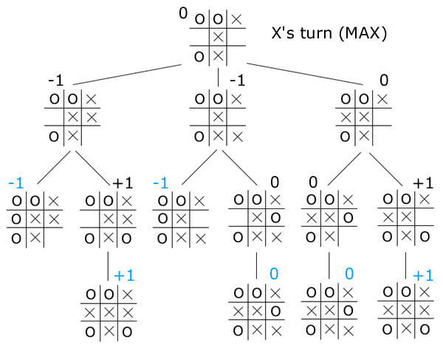

First Approach and Key Factors
Before writing any code there must be a clear plan
Brute force? Maybe a modified DFS algorithm? O(n*m*4*calculatePath(O(n*m)) = O((n*m)²) Exponential
What is our objective? Is there a more optimal way to approach the solution?
Maximize path length and steepness. Minimax algorithm
Understanding the rules of the game
The robots can only move in 4 directions and to higher points in the map
The highest spaces are likely endpoints (PriorityQueue) O(n*log(n)). O(log(n))
As long as the longest path is remembered there is no need to recalculate

Slide 4
Maximizing length and applying dynamic programming
Any other case (choose best path)
Base case (length = 1)
Length 1 + 1
Highest points will be the ends of paths
4 quick checks for the best path
Length 3 + 1
Steepness: 2
Length 3 + 1
Steepness: 4
Length 4 + 1
Remember the best path and its
length
Remember the best path and its
length
Both cases are O(1) and they happen at most n*m times O(n*m)

Slide 5

Example Execution
10
Steps
10
10: Length 1, Local best: 10, Global best: 10
9: Length 1, Local best: 9, Global best: 10
7: Length 2, Local best: 10-7, Global best: 10-7
5: Length 3, Local best: 10-7-5, Global best: 10-7-5
4 (left): Length 3, Local best: 10-7-4, Global best: 10-7-4
4 (right): Length 4, Local best: 10-7-5-4, Global best: 10-7-5-4
9
9
10-7
7
5
9-7
10-7-5
10-7-4
10-7-5-4
4
4

Slide 6
DEMO & Test Case 9
Case 9
Steepest path length: 15
List of paths:
1422-1412-1316-1304-1207-1162-965-945-734-429-332-310-214-143-0
--------------------------------------------------

Slide 7
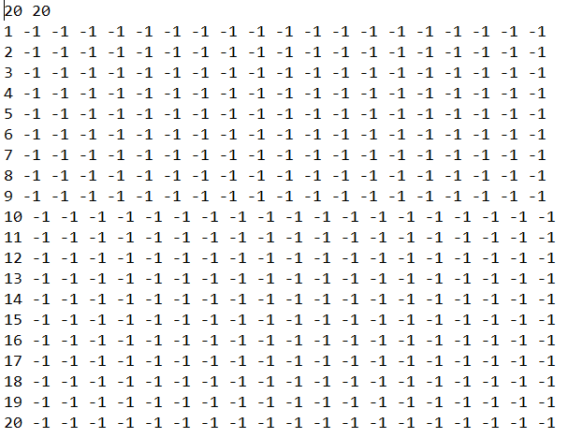
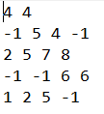
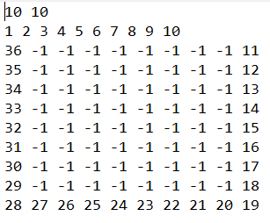
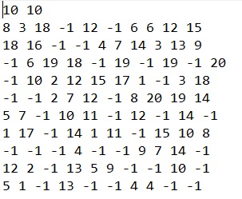



Test Cases
Case 4
Steepest path length: 20
List of paths:
20-19-18-17-16-15-14-13-12-11-10-9-8-7-6-5-4-3-2-1
------------------------------------
Case 6
Steepest path length: 6
List of paths:
8-7-6-5-2-1
-------------------------------
Case 5
Steepest path length: 36
List of paths:
36-35-34-33-32-31-30-29-28-27-26-25-24-23-22-21-20-19-18-17-16-15-14-13-12-11-10-9-8-7-6-5-4-3-2-1
------------------------------------
Case 8
Steepest path length: 8
List of paths:
19-17-15-12-11-10-7-2
---------------------------------

Slide 8
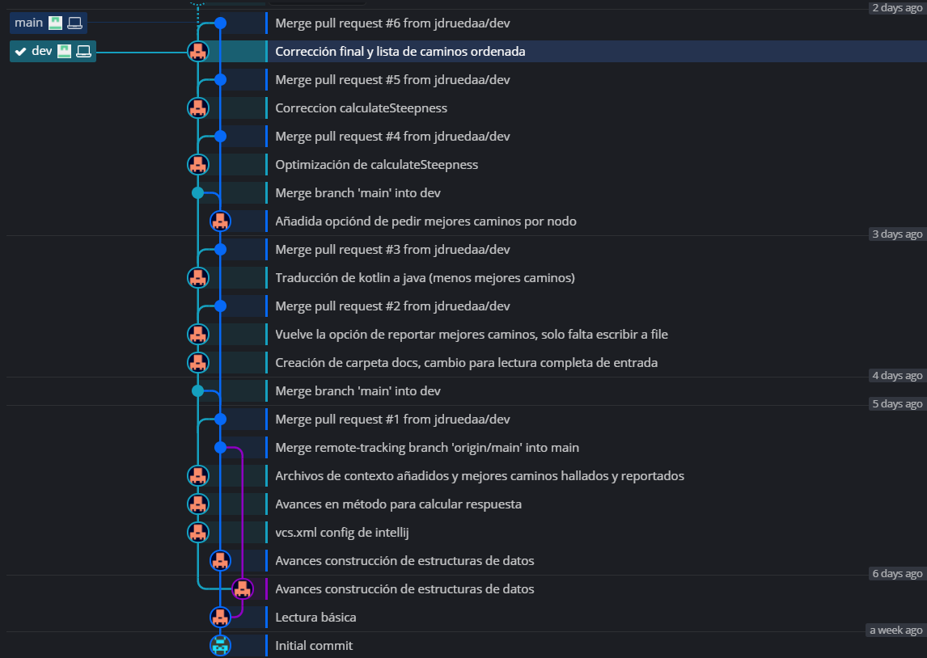
Development practices
Two branches in a GitHub repository: Main and Dev
Main: Only stable iterations
Dev: Working branch, any merge from dev to main requires a pull request
GitFlow with GitKraken

Slide 9
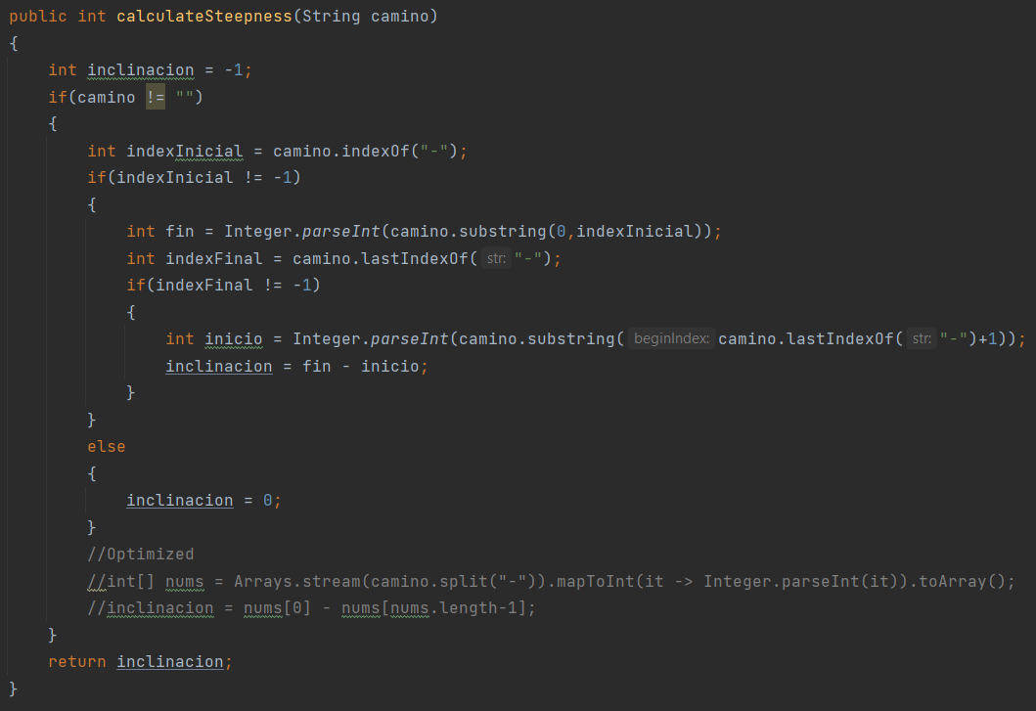
Optimizations
"X - # - …. - (N-1)"
X>#
#
...
N-1
O(n*m)
X
N-1
O(1)
"X - # - …. - (N-1)"

Slide 10

QA

Slide 11
Thank you!

